Slide 1

Human Resources. The Right Way

Slide 2
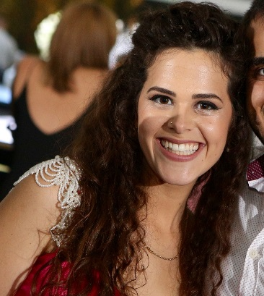
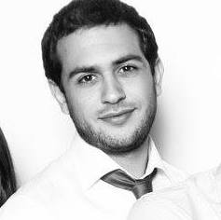
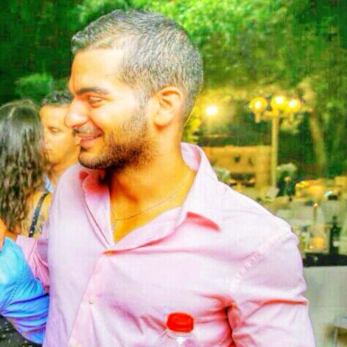
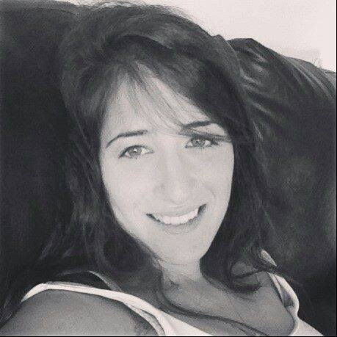
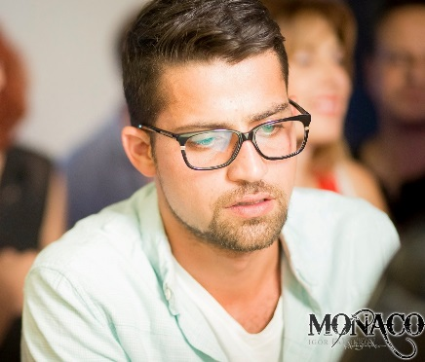

We are:
We are all third-year students programmers for Software Engineering in JCE.
NICE TO MEET YOU ☺

Slide 3

The main idea
“MadeInJLM” wanted to change the concept of human resources in Jerusalem, we did it together!
We worked on the company side, building an interface to allow them to view and choose from a repository of greats students.

Slide 4
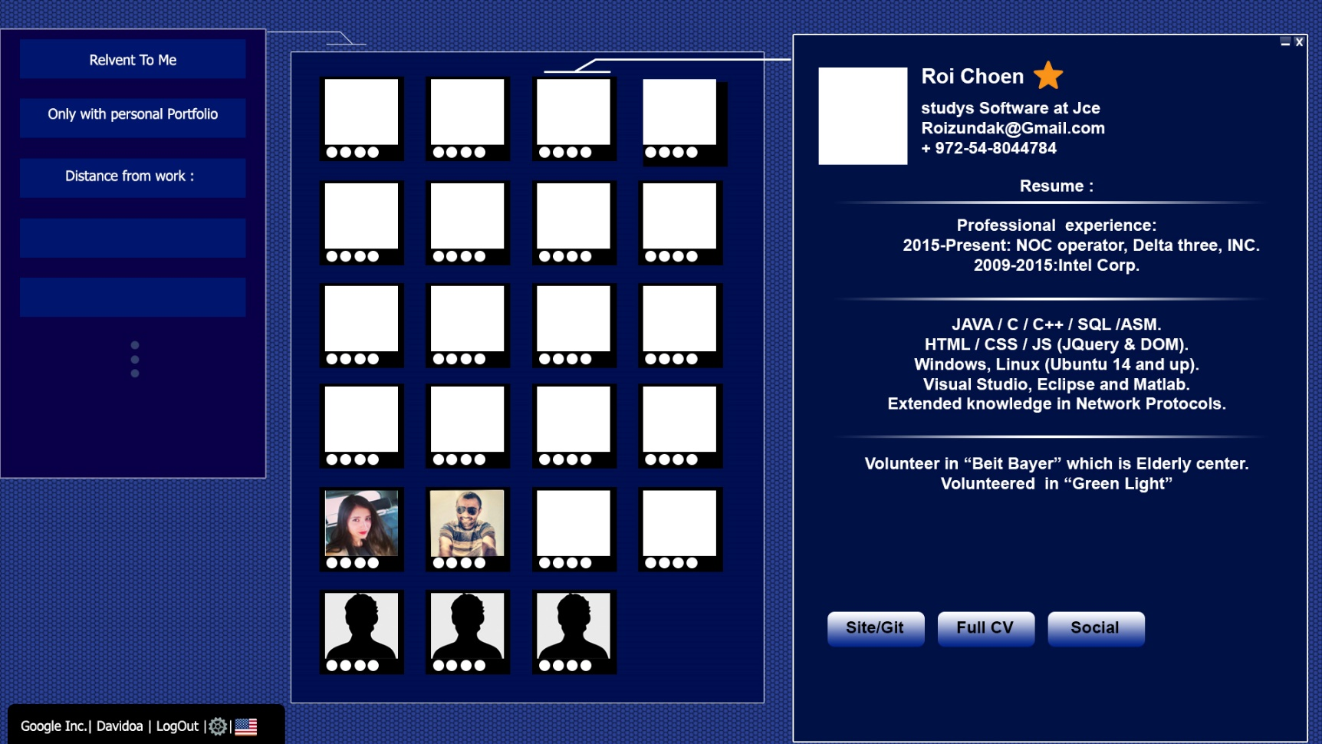
FIRST DESIGEN

Slide 5

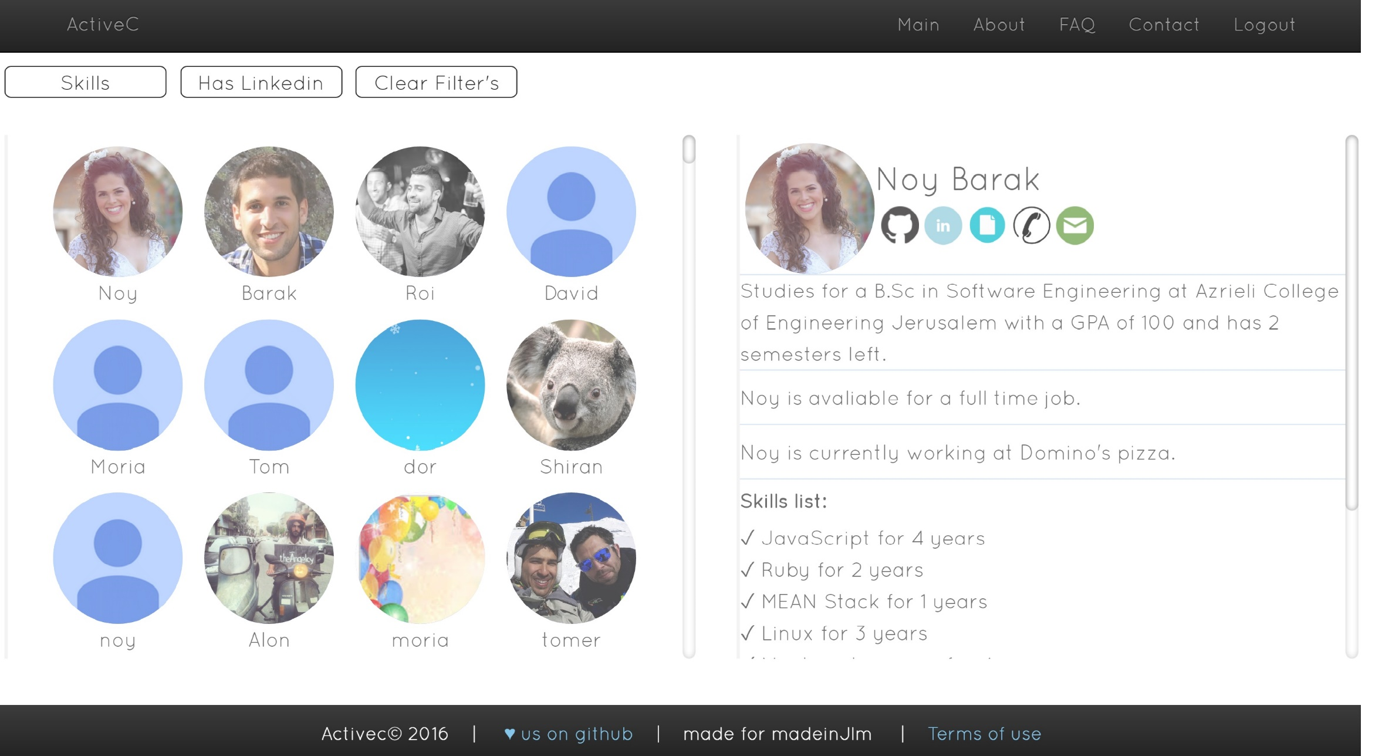
OUR FINAL DESIGN

Slide 6
thanks to the masters!
To MadeInJLM and their awesome contact Tom Wininger.
To the course staff : DR. Reuven Yagel, Itamar Sharifi and Ziv Moraly
To the other groups
To our GREAT TEAM.

